Slide 1


Window Manufacturing
Professor Matthew Lanham
Academic Director, MS BAIM Program
Associate Director of Student Engagements,
Krenicki Center for Business Analytics & Machine Learning
MatthewALanham.com
Notes:
http://krannert.purdue.edu/news/press/Logo.asp

Slide 2
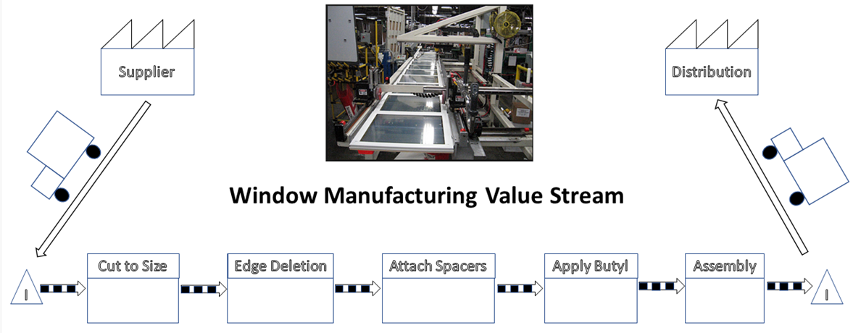
Example
Imagine you are a process engineer at a window manufacturing company. Glass is shipped from different suppliers, and various processes occur at your company to distribute the windows to distributors.
Data Mining & Predictive Analytics
2

Slide 3
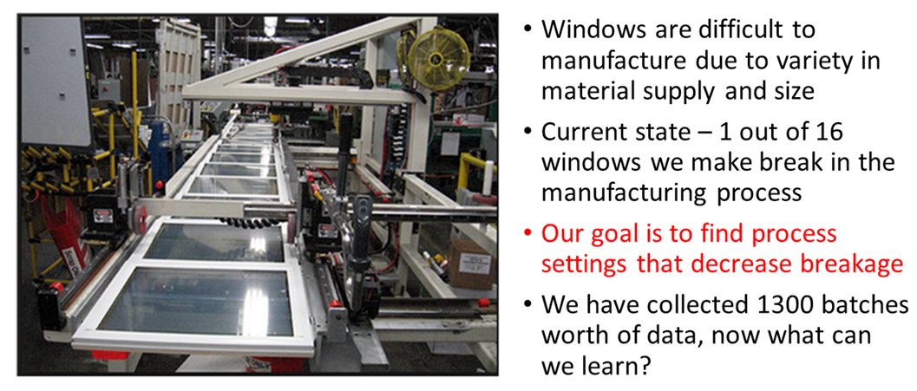
Example
Complications in our process.
Data Mining & Predictive Analytics
3

Slide 4
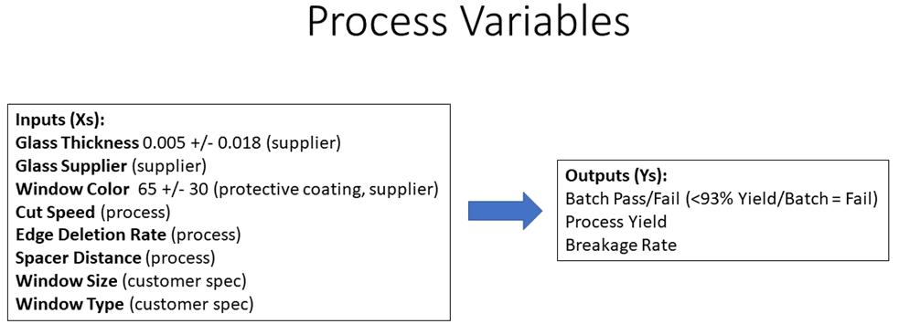
Example
Data that has been collected.
Data Mining & Predictive Analytics
4

Slide 5
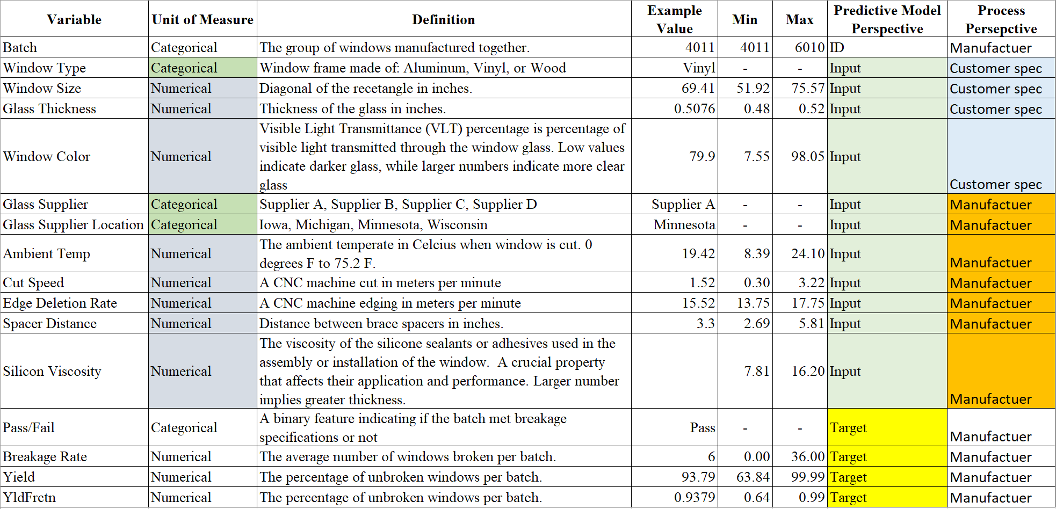
Data Dictionary
Data Mining & Predictive Analytics
5

Slide 6
Example: Business Problem to Analytics Problem
Business Problem:
We know the number of broken windows per batch and features about those windows and their process. Find process settings that decrease breakage.
Analytics Problem:
Here we have a measured target variable (Y). We can start thinking this problem might lend nicely to a predictive model where we make predictions about the breakage rate?
A predictive model would allow us to predict under various scenarios what is likely to break for planning purposes in the future. Also, since we want to decrease breakage, make inferences about which process is contributing most to breakage so we can try to reduce that (set the right settings) if possible.
Lets try two predictive approaches.
Make it a classification-type problem – predict pass/fail
Make it a regression-type problem – predict Breakage Rate
Data Mining & Predictive Analytics
6

